Slide 1
Group 7 Presentation
Presenters:
Ralph Baroud, Daniah Al Bayati, Jeremy Hartnett, Shayon Keating, David Mitchell, and Velkis Moreno

Slide 2
Motivation
Understanding the historical trends of Atlanta’s real estate is crucial in determining the future state of the market as well as making informative decisions that can lead to more bang for your buck. Therefore, as a group, we felt that if we can find data trends between a zip code, their list price, and their days on the market, we may present rich opportunities within the real estate market.
Our goal is to provide a potential buyer or investor an understanding of when is the best time to buy, what zip codes have the most days on the market, and if there is any correlation between listing price and days on the market for a specific zip code.

Slide 3
Problem Statement
When looking for the right Atlanta property, there are too many variables and details to consider that makes the buying decision that more difficult. For example, real estate sites like Zillow or Realtor.com are not providing an optimized an in-depth analysis to quickly let the buyer/investor know if a specific neighborhood’s listing has been sitting on the market due to other underlying factors nor do they provide future listing forecasts of pricing and number of days to expect they will be on the market.
Although, the average buyer/investor makes decisions based on public information, websites or even gut feeling, through the use of historical data, there is potential to provide forecasts for future listings.
Hypothesis
Through the use of historical data, we can describe variation in sales price, time on market, and demand for listings

Slide 4
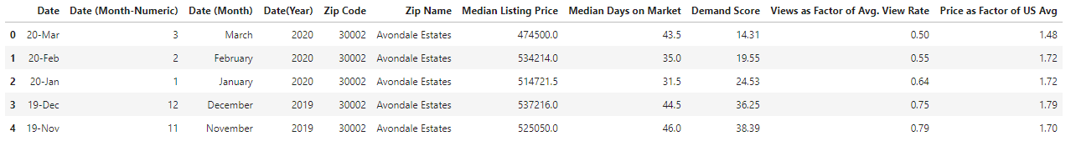
A peek into the Database
Here we show a glimpse of our dataset and explain some variable definitions
Dictionary terms
Median Listing Price: The median listing price within the specified geography during the specified month.
Median Days on Market: The median number of days property listings spend on the market within the specified geography during the specified month. Time spent on the market is defined as the time between the initial listing of a property and either its closing date or the date it is taken off the market
Demand Score: The demand score is an index representing a zip code, county or metro’s listing page views per property ranking compared to other zip codes, counties, or metros.
Views as a factor of Avg. View Rate: Count of views a typical property receives in the specified geography divided by the count of views a typical property receives in the US overall during the same month.
Price as Factor of US Avg: The median listing price within the specified geography divided by the median listing price for the US overall during the same month.

Slide 5
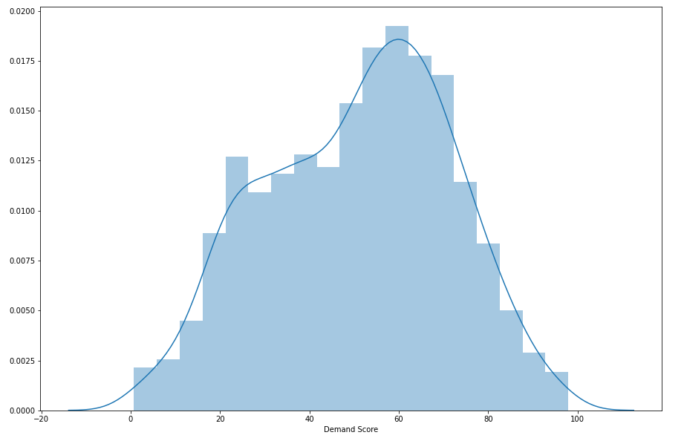
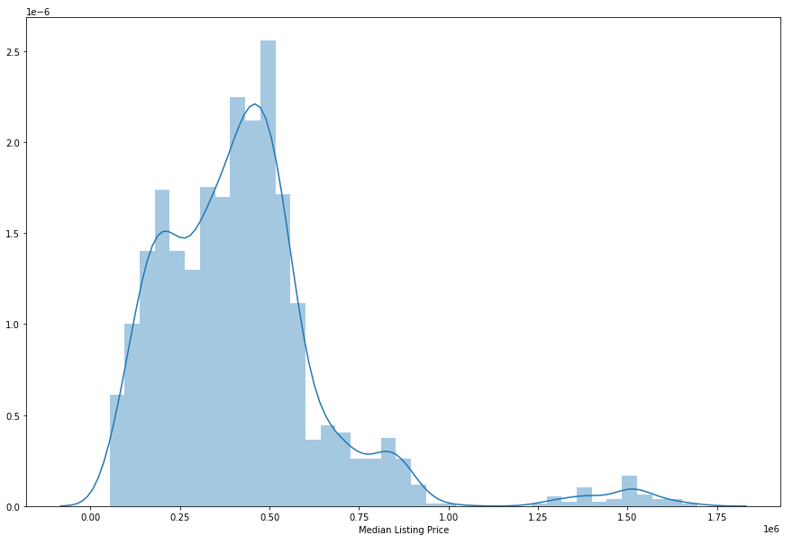
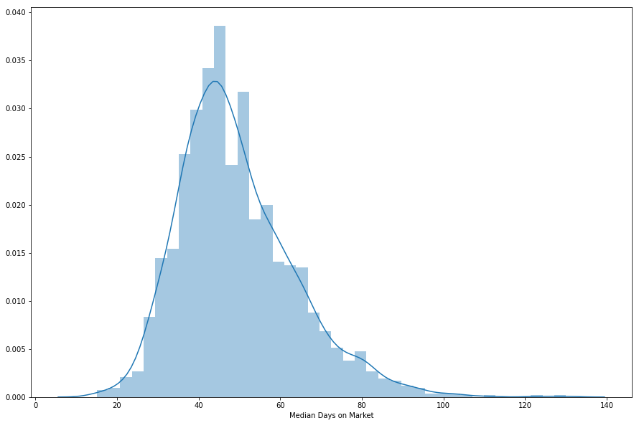
A peek into the Database cont.
41 Zip Codes
8 Neighborhoods
45 dates
~1800 data points

Slide 6
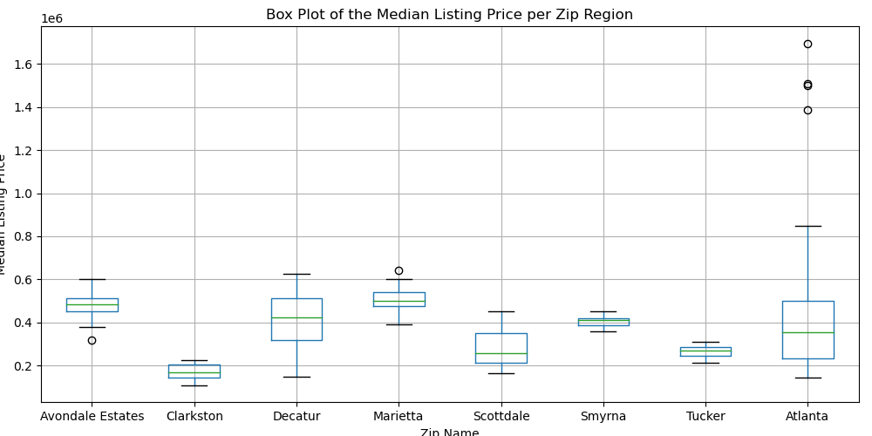
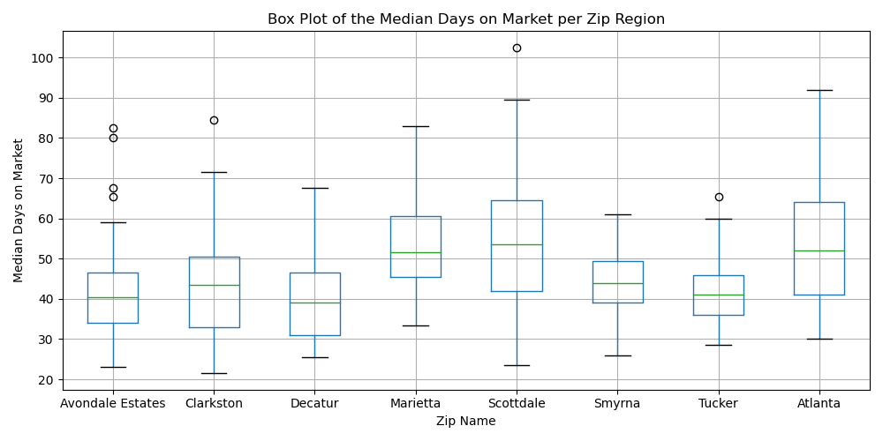
Analysis one - Zip Code
Zipcode vs. Median Sales Price
Zipcode vs. Median Days on Market
(Anova) Are some locations significantly different?: pval:7.793e-19 - Yes
(Paired T Tests) Significantly different locations: Practically all of them
(Anova) Are some locations significantly different?: pval: 9.82e-15 - Yes
(Paired T Tests) Significantly different locations: Practically all of them

Slide 7
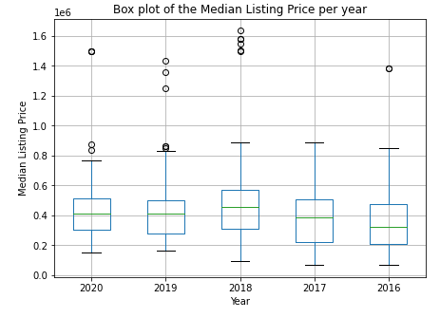
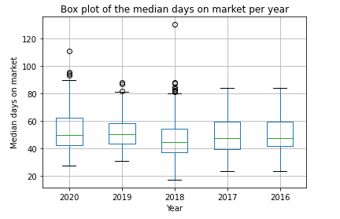
Analysis Two- Year
Year vs. Median Sales price
Year vs. Median time on market
(Anova) Are some years significantly different?: pval- .001 - Yes
(Paired T Tests) Significant different years: 16’ vs. all; 17’ vs. 18’.
(Anova) Are some years significantly different?: pval- 8.94e-05 Yes
(Paired T Tests) Significant different years: ‘17 vs. ‘16, ‘19,’ 20; ‘18 vs. ‘19, ‘20

Slide 8
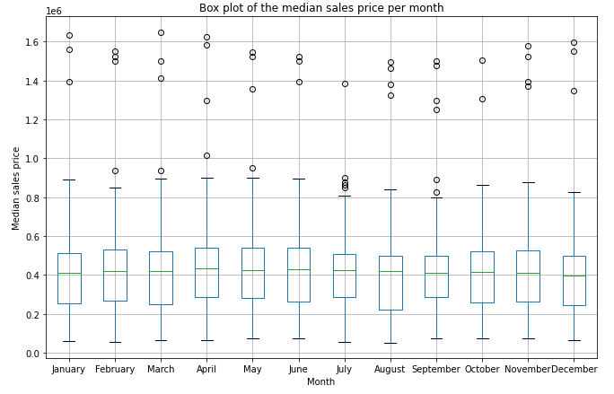
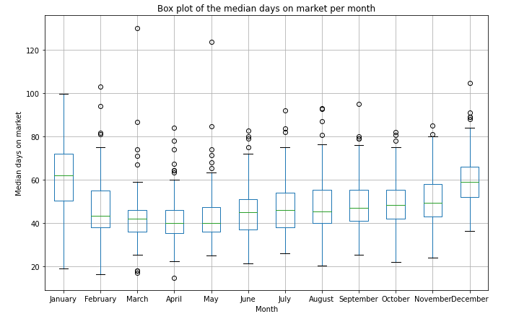
Analysis Two- Month
Month vs. Median Sales price
Month vs. Median time on market
(Anova) Are some months significantly different?: .977 - No
(Paired T Tests) Significant different years: None
(Anova) Are some months significantly different?: 1.06e-77 - Yes
(Paired T Tests) Significant different years: Practically all of them

Slide 9
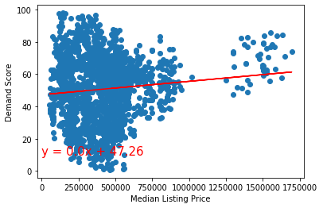
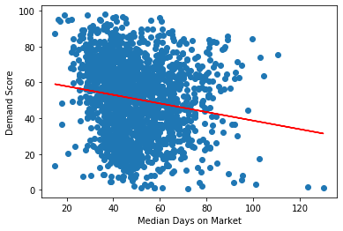
Analysis Three - Demand Score
Demand score vs. Median Sales price
Slight positive correlation
Demand score vs. Median time on market
Slight negative correlation
Scatter plot
jeremy
The r-squared is: 0.00979497638978793
The r-squared is: 0.027249976911454293

Slide 10
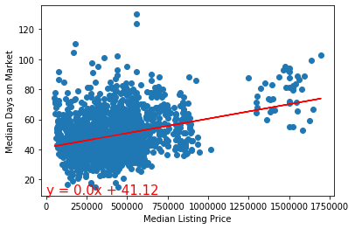
Analysis Four - TOM vs. Median Sales Price and Vice Versa.
Median sales vs. time on market
Shayon
The r-squared is: 0.1116070657989962
Notes:
I think we should stick to one x bar and one y bar instead of inverting it, could lead to weird results

Slide 11
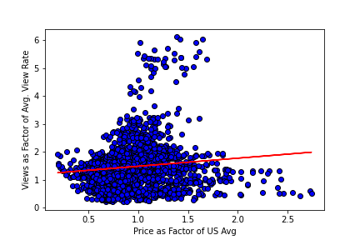
Analysis Five- Views vs. Price
Views vs. price factor of US Avg.
r-squared is: 0.013242630445843884
Y = 0.29x + 1.19
Daniah

Slide 12
Discussion / Post Mortem
Based on our findings, we were able to determine a correlation around pricing, days on market, dates, zip code and demand.
Ex: In 2018 we see higher average prices, with less days on the market, but a higher demand, versus in 2019, where we see lower average pricing, with more days on the market, and less demand.
Using big data analytics to determine trends allows us to forecast future listings even before they hit the market.
What does this mean for real estate investing?
For a buyer or seller, this allows them to determine which time of the year would be best to buy or list a property.
As for the investor, it allows them to get ahead of the market, alleviates the uncertainty behind pricing, and even predict profitability.

Slide 13
Next steps
Find a more specific dataset that will allow analysis on a per property basis, add in more variables unique to each property, e.g. number of bedrooms, neighborhood amenities, etc.
Create filterable interactive geo-visualizations of our data that would allow for simpler processing of the data enable insight generation for potential buyers/investors
Build a multi variable linear regression and more advanced machine learning models to transition from descriptive models to predictive models of the data. This step would allow for price forecasting for a property/neighborhood given a set of filterable features.
Build a platform / website for our model and begin A/B testing given preliminary user feedback

Slide 14
Questions?

